Slide 1
UML Modelling
Instructor: Mehroze Khan

Slide 2
Revision up till now
Set of Requirements
Use Case
Diagram
High-Level and Expanded Use cases
Domain Model
Use case Identification
Boss test
Elementary Business Process
Size Test
Main Success Scenarios
Non-Functional Requirements
Functional Requirements

Slide 3
How to Create Domain Model

Slide 4
How to Create Domain Model
Find conceptual classes
Draw them as classes in a UML class diagram
Add associations and attributes

Slide 5
Finding Conceptual Classes
Three Strategies to Find Conceptual Classes
Reuse or modify the existing model if one exists
Use a Category List
Identify noun phrases in your use-cases

Slide 6
Method 1: Reuse or Modify Existing Models
There are published, well--‐crafted domain models and data models (which can be modified into domain models) for many common domains, such as inventory, finance, health, and so forth..
Reusing existing models is excellent, but out of the scope of this course

Slide 7
Method 2: Use a Category List
We can kick-start the creation of a domain model by making a list of candidate conceptual classes.
Table contains many common categories that are usually worth considering, with an emphasis on business information system needs.
The guidelines also suggest some priorities in the analysis. Examples are drawn from the
POS
Monopoly
Airline reservation domains

Slide 8
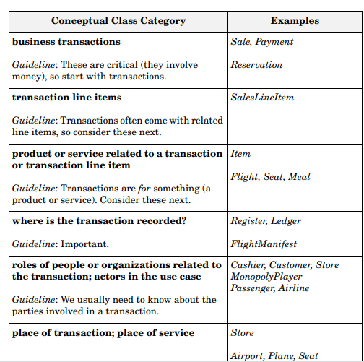
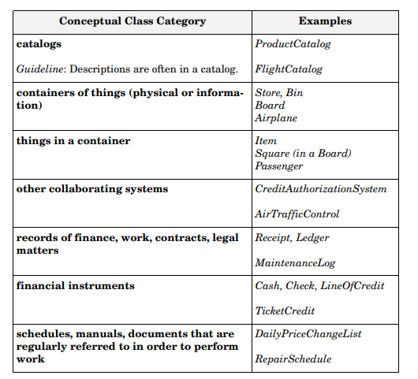
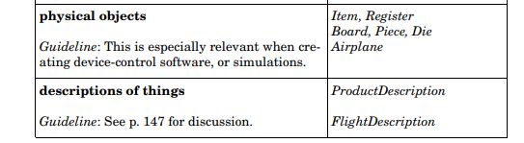

Slide 9
Method 3: Finding Conceptual Classes with Noun Phrase Identification
Another useful technique (because of its simplicity) is linguistic analysis: Identify the nouns and noun phrases in textual descriptions (use cases or other documents) of a domain and consider them as candidate conceptual classes or attributes.

Slide 10
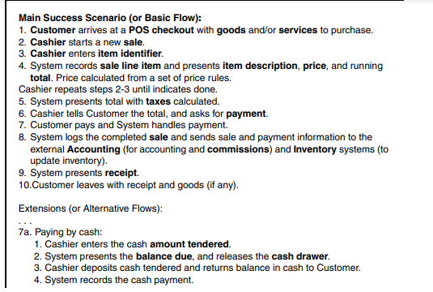
Method 3: Finding Conceptual Classes with Noun Phrase Identification
Basic Flow for a POS System

Slide 11
Example: Find and Draw Conceptual Classes
Case Study: POS Domain
From the category list and noun phrase analysis, a list is generated of candidate conceptual classes for the domain
Sale
CashPayment
SalesLineItem
Item Register
Cashier
Customer
Store
ProductDescription
ProductCatalog
.
.
.
Decide which ones are classes and which ones are attributes
Add attributes and relation to the identified domain classes

Slide 12
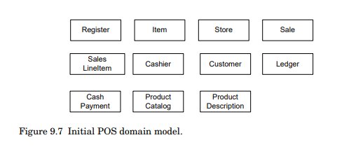
POS Domain Model

Slide 13
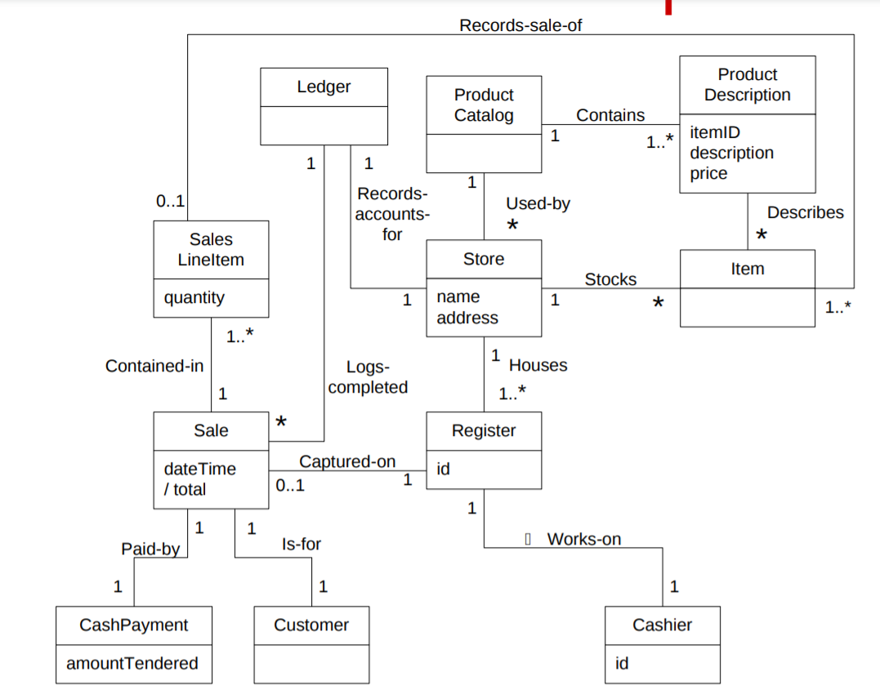

Slide 14
Domain Modeling Guidelines
On Naming and Modeling Things: The Mapmaker
Mapmakers uses the names of the territory--they do not change the names of cities on a map. For a domain model, this means to use the vocabulary of the domain when naming concepts and attributes. For example, if developing a model for a library, name the customer a “Borrower” --the term used by the library staff.
A mapmaker deletes things from a map if they are not considered relevant to the purpose of the map; a domain model may exclude concepts in the problems domain not pertinent to the requirements.
A mapmaker does not show things that are not there, such as a mountain that does not exist. Similarly, the domain model should exclude things not in the problem domain under consideration.

Slide 15
Domain Modeling Guidelines
On Naming and Modeling Things: The Mapmaker
Make a domain model in the spirit of how a mapmaker works:
Use the existing names in the territory.
Exclude irrelevant features.
Do not add things that are not there.

Slide 16
Resolving Similar Concepts - POST versus Register
Rule of thumb, a domain model is not absolutely correct or wrong, but useful tool of communication.
Both POST and Register are equally useful terms, but POST will give a better implementation view.

Slide 17

Concept vs. Attribute
A Common Mistake in Identifying Concepts:
Attribute OR Concept?
If we do not think of some concept X as a number or text in the real world,
X is probably a concept, not an attribute.
If in doubt, make it a separate concept.

Slide 18
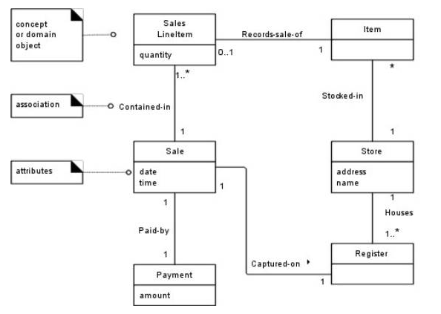
UML Attribute Notation

Slide 19
Conclusion
When in doubt if the concept is required, keep the concept.
Why?: During the analysis phase, it's important to capture all potentially relevant elements of the system. It's easier to later remove unnecessary classes or merge them with others during design or implementation than to add a missing concept that wasn’t initially considered.
Example: If you're not sure whether "Address" should be a separate class, it’s safer to keep it as a class in the diagram. You can refine it later.

Slide 20
Conclusion
When in doubt if the association is required, drop it.
Why?: Associations add complexity to your model. Unnecessary relationships can clutter the diagram and make the system harder to understand and implement. It’s easier to add an association later if it turns out to be needed, than to remove it if it proves to be unnecessary.
Example: If you’re not sure whether there should be a direct association between "Customer" and "OrderHistory," it’s better to omit it initially. You can always introduce it later if you determine that it's required.

Slide 21
Monopoly Game domain model (first identify concepts as classes)
Monopoly Game
Dice
Board
Player
Piece
Square

Slide 22
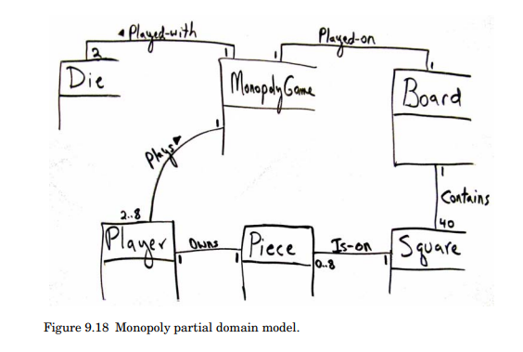

Slide 23
Visualizing Domain Models

Slide 24
Statements about a Course Management System
During a semester, a lecturer delivers one or more lectures
Sometimes the lecturer is on leave to focus on doing research, in this case (s)he does not give a lecture
A student usually attends many, unless (s)he has something better to do
During the semester there will be several exercises which are meant to be solved by small study groups
Each student is assigned to one particular study group for the whole semester
A study group consists of two to three students
After submission of a solution by a study group it is graded by a tutor
...

Slide 25







A class describes a set of objects with the same semantics, properties and behavior.
During a semester a lecturer delivers one or more lectures
A student usually attends many lectures, ...
During the semester there will be several exercises...
Each student is assigned to one particular study group for the whole Semester
... it is graded by a tutor
Tutor
Exercise
Semester
Student
Lecture
Lecturer
Grade
Study Group

Slide 26
Derived Attribute
A derived attribute is an attribute in a class that is not stored directly but is calculated or derived from other attributes or entities in the system.
Employee
firstName lastName dateOfBirth /age
Rectangle
length width /area
Derived Attribute
Derived Attribute
Notes:
The attribute or entity from which a derived attribute is calculated does not need to be in the same class. In fact, it is common for derived attributes to be based on data from other related classes. The derived attribute can use data from one or more other classes that are associated with the class containing the derived attribute.

Slide 27




Attributes are logical data values of an object.
... after submitting a solution, it is graded by a tutor
The bonus is a relative bonus that reﬂects the relative number of exercise points gained during the semester
....
Student
name /bonus
attributes
derived attribute ("/")
The bonus is derived

Slide 28
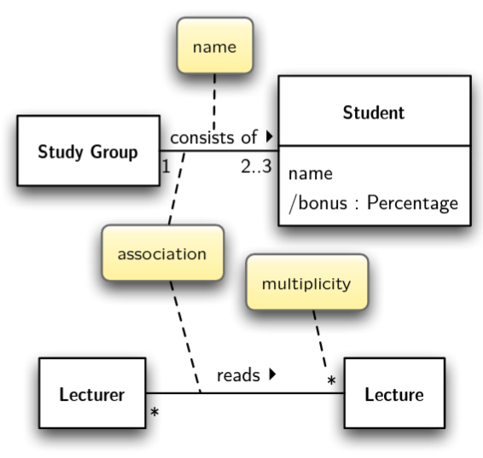
The ends of an association are called roles. Roles optionally have a multiplicity, name and navigability.
A lecturer reads one or more lectures...
A student usually attends many lectures...
A study group consists of two to three students...
During the semester there will be several exercises
1..

Slide 29
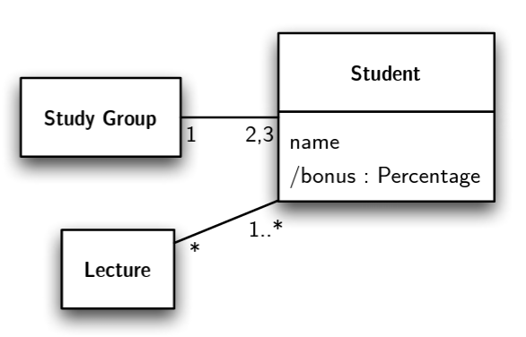
The multiplicity defines how many instances of a class A can be associated with one instance of a class B at any particular moment.
(e.g., * ≙ zero or more; 1..10 between 1 and 10; 1,2 one or two)
A student usually attends many lectures, unless (s)he has something better to do
A study group consists of two to three students...
...

Slide 30
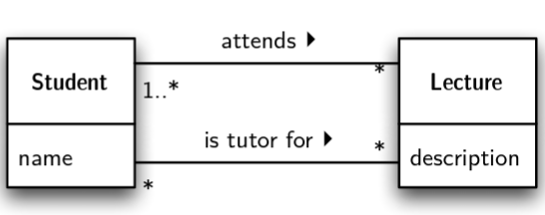
Two Classes can have multiple associations
A student usually attends many lectures, unless the student has something better to do
A study group consists of two to three students; after submitting a solution it is graded by a tutor who is also a student

Slide 31

A preliminary domain model for a course management system.
Student
name /bonus
Lecture
description
Lecturer
name
attends ‣
◀ reads
1..*
1..*
1..*
*
consists of ‣
2..3
owns ‣
1
12..14
Exercise
task submission date exercise points
1
Study Group name
solves ‣
*
*
Solution
achieved exercise points
The Domain Model is sometimes also called a Visual Dictionary.

Slide 32
Association Classes
An association class represents a relationship between two classes that also has attributes or operations of its own. It combines both an association and a class into a single concept, allowing you to model a relationship that has its own properties.
Example: In a course management system, if you have Student and Course classes, and you want to capture attributes like grade or enrollmentDate specific to the relationship between a Student and a Course, you might model this with an association class, Enrollment.
Student
studentID name
registers ‣
Course
courseID courseName
*
*
Enrollment
grade enrollmentDate

Slide 33
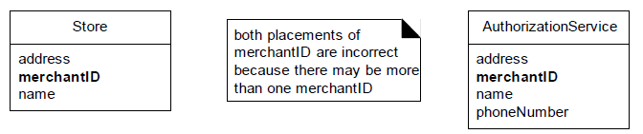
Association Classes
The following domain requirements set the stage for association classes:
Authorization services assign a merchant ID to each store for identification during communications.
A payment authorization request from the store to an authorization service needs the merchant ID that identifies the store to the service.
Furthermore, a store has a different merchant ID for each service.
Where in the Domain Model should the merchant ID attribute reside?
Placing merchantID in Store is incorrect because a Store can have more than one value for merchantID. The same is true with placing it in Authorization-Service

Slide 34
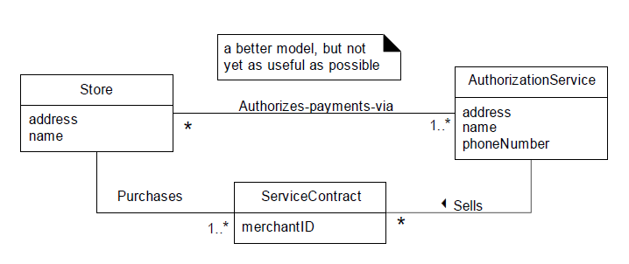
Association Classes
This leads to the following modeling principle:
In a domain model, if a class C can simultaneously have many values for the same kind of attribute A, do not place attribute A in C. Place attribute A in another class that is associated with C.
For example:
A Person may have many phone numbers. Place phone number in another class, such as PhoneNumber or ContactInformation, and associate many of these to Person.

Slide 35
Association Classes
In the business world, what concept formally records the information related to the services that a service provides to a customer?—a Contract or Account.
The fact that both Store and AuthorizationService are related to ServiceContract is a clue that it is dependent on the relationship between the two.
The merchantID may be thought of as an attribute related to the association between Store and AuthorizationService.
This leads to the notion of an association class, in which we can add features to the association itself. ServiceContract may be modeled as an association class related to the association between Store and AuthorizationService.

Slide 36
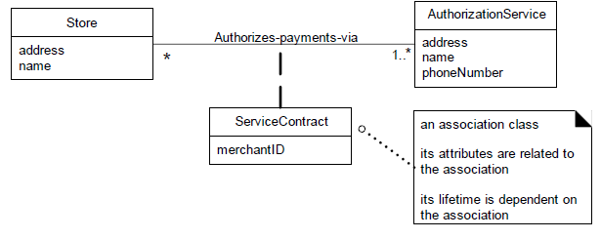
Association Classes
In the UML, this is illustrated with a dashed line from the association to the association class.
Figure visually communicates the idea that a Service-Contract and its attributes are related to the association between a Store and AuthorizationService, and that the lifetime of the ServiceContract is dependent on the relationship.

Slide 37
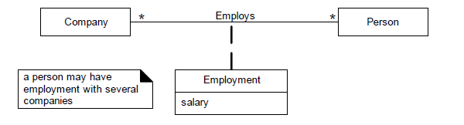
Association Classes
Clues that an association class might be useful in a domain model:
An attribute is related to an association.
Instances of the association class have a life-time dependency on the association.
There is a many-to-many association between two concepts, and information associated with the association itself.

Slide 38
Hospital Management System
Ward is a division of a hospital shared by patients who need a similar kind of care. In a hospital, there are several wards, each of which may be empty or have in it one or more patients. Each ward has a unique name. Wards are differentiated by gender of its patients, i.e., male wards and female wards. Every ward has a fixed capacity, which is the maximum number of patients that can be on it at one time (i.e., the capacity is the number of beds in the ward).
Different wards may have different capacities. The doctors in the hospital are organized into teams (also called firms). Each team has a unique name or code (e.g., Orthopedics or Pediatrics) and is headed by a consultant doctor (in the UK, Republic of Ireland, and parts of the Commonwealth)
Consultant doctor is the senior doctor who has completed all his or her specialist training, residency and practices medicine in a clinic or hospital, in the specialty learned during residency.
The rest of the team are all junior doctors. Each doctor could be a member of no more than one team. Each patient is in a single ward and is under the care of a single team of doctors. A patient may be treated by any number of doctors, but they must all be in the team that cares for the patient.
A doctor can treat any number of patients. The team leader accepts ultimate responsibility, legally and otherwise, for the care of all the patients referred to him/her, even with many of the minute-to-minute decisions being made by subordinates.

Slide 39
Hospital Management System
Ward is a division of a hospital shared by patients who need a similar kind of care. In a hospital, there are several wards, each of which may be empty or have in it one or more patients. Each ward has a unique name. Wards are differentiated by gender of its patients, i.e., male wards and female wards. Every ward has a fixed capacity, which is the maximum number of patients that can be on it at one time (i.e., the capacity is the number of beds in the ward).
Different wards may have different capacities. The doctors in the hospital are organized into teams (also called firms). Each team has a unique name or code (e.g., Orthopedics or Pediatrics) and is headed by a consultant doctor (in the UK, Republic of Ireland, and parts of the Commonwealth)
Consultant doctor is the senior doctor who has completed all his or her specialist training, residency and practices medicine in a clinic or hospital, in the specialty learned during residency.
The rest of the team are all junior doctors. Each doctor could be a member of no more than one team. Each patient is in a single ward and is under the care of a single team of doctors. A patient may be treated by any number of doctors, but they must all be in the team that cares for the patient.
A doctor can treat any number of patients. The team leader accepts ultimate responsibility, legally and otherwise, for the care of all the patients referred to him/her, even with many of the minute-to-minute decisions being made by subordinates.

Slide 40
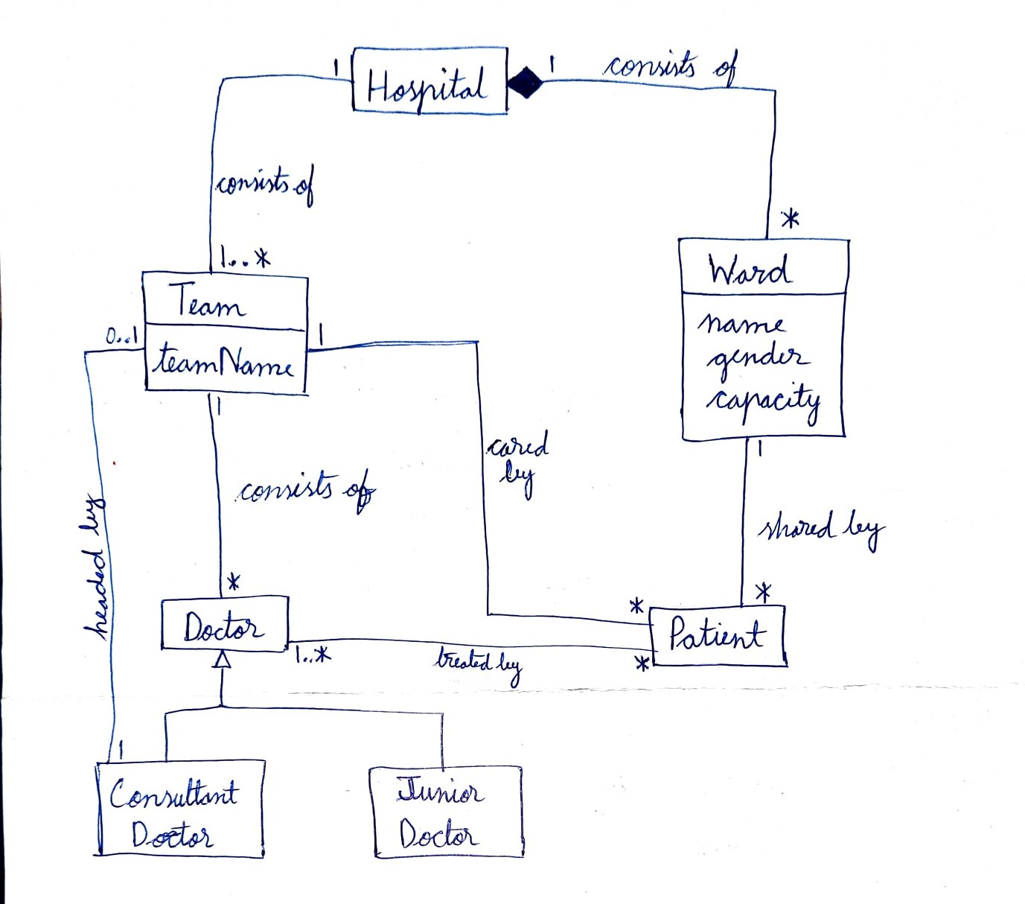

Slide 41
References
Satzinger, John W., Robert B. Jackson, and Stephen D. Burd. Systems analysis and design in a changing world. 4th Edition.
Larman, Craig. Applying UML and patterns: an introduction to object oriented analysis and design and interative development. Pearson Education India, 2012.
Object-Oriented Modeling and Design with UML, Michael R. Blaha and James R. Rumbaugh, 2nd Edition, Pearson, 2005.

